Slide 1
Reverse Breakdown Mechanism in PN - Junctions

Slide 2
Reverse Breakdown Mechanisms
Zener breakdown occurs when the electric field is sufficiently high to pull an electron out of a covalent bond (to generate an electron-hole pair).
Avalanche breakdown occurs when electrons and holes gain sufficient kinetic energy (due to acceleration by the E-field) in-between scattering events to cause electron-hole pair generation upon colliding with the lattice.

Slide 3
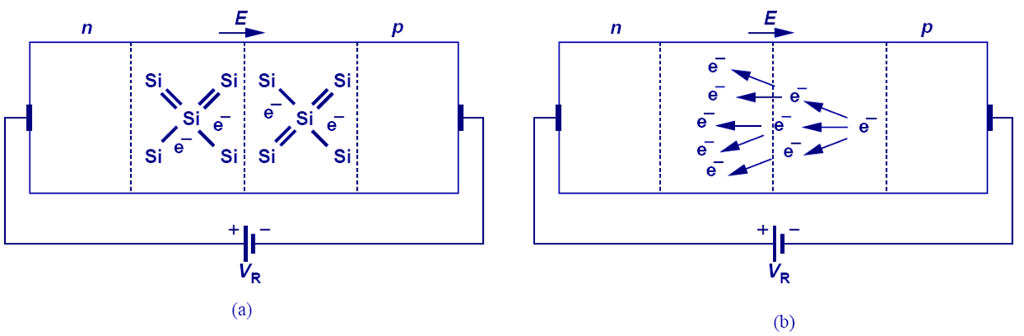

Slide 4
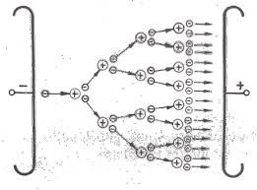
Avalanche Mechanism

Slide 5
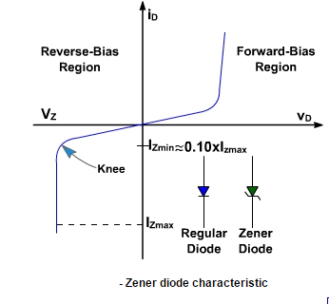


Slide 6
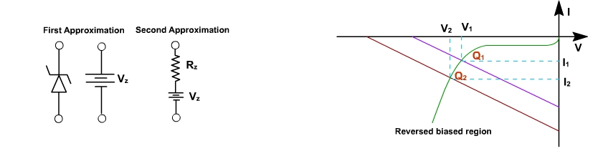

Slide 7
ZENER Diode as a Regulator

Slide 8
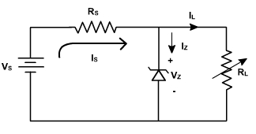
Zener Regulator
The circuit is designed such that the diode always operates in the breakdown region and the voltage V_{Z} across it remains fairly constant even though the current I_{Z} through it vary considerably.
If the load I_{L} should increase, the current I_{Z} should decrease by the same percentage in order to maintain load current constant I_{s}. This keeps the voltage drop across R_{s} constant and hence the output voltage.
If the input voltage should increase, the zener diode passes a larger current, that extra voltage is dropped across the resistance R_{s}. If input voltage falls, the current I_{Z} falls such that V_{Z} is constant.

Slide 9
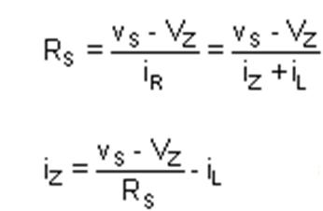
We now analyze the circuit to determine the proper choice of R_{s}. For the circuit shown in figure,
The current through the diode, i_{Z}, is a minimum (I_{Z min}) when the load current, i_{L} is maximum (I_{L max}) and the source voltage, v_{s} is minimum (V_{s min}).
The current through the diode, i_{Z}, is a maximum (I_{Z max}) when the load current, i_{L}, is minmum (i_{L min}) and the source voltage v_{s}is minimum(V_{s max}).

Slide 10



